Slide 1
Exploring Sustainable Practices in Dentistry
International Conference of PhD Students and Young Doctors December 11th, 2024
Szilárd Dávid Kovács
Szilvia Zörgő
PhD Student,
Semmelweis University, Institute of Behavioural Sciences
Supervisor,
University of Amsterdam, Computational Social Science

Slide 2
The environmental crisis and healthcare
WHO 2023: 24% of fatalities globally can be linked to environmental hazards (WHO 2023)
Causes: Extreme weather events, heat, flood, diminished air and water quality
Effects: Direct threaths to human life, Food insecurity, Water insecurity, Infectious diseases, Pulmonary diseases, Cardiovascular diseases, Adverse birth outcomes, Infectious diseases, Psychological effects, ACCESS TO HEALTH CARE, etc.
Unfairness: Countries which distribute less to the problem suffer more (Roque et al. 2021, Zielenski 2022)

Slide 3
The environmental crisis and healthcare
OECD countries + India + China: 3,3-8,1% of total carbon footprint stems from health care (Pichler et al. 2019, Lenzen et al. 2020)
NHS: Achieve zero net carbon submission by 2040
Public is not aware of healthcare’s role in sustainability, but they support green transformation in medicine when asked (The Health Foundation 2024)
Healthcare’s ecological load: Operation of facilities + Transport of staff and patients + High demand for medical goods (especially single-use items) (https://www.parlament.hu/documents/d/guest/infojegyzet_2023_30_egeszsegugy_eghajlatvaltozas)

Slide 4
The environmental crisis and healthcare
Most radical solutions are generally not accpeted (such as not treating patients who need treatment, or disregarding patient autonomy to force more sustainable alternatives)
Green principles in medicine (Richie 2019)
Distributive justice
Resource conversation
Simplicity
Ethical economics
(In a nutshell: Ethical medicine fulfills basic needs of more people with simple procedures first)
This idea is extremely controversial
Policymakers or physicians? (ten Have and Gordijn 2023)

Slide 5
More practical approaches for dentistry
Dentistry within medicine:
Low emphasis on life and death issues
More emphasis on esthetics
Especially reliant on materials
Practical approaches for more sustainable dentistry
Less patient visits: Combining multiple interventions in one session
Less need for materials:
Prevention
Digital dentistry
Minimizing material usage: Reusing, Recycling, Reducing (e.g., medication) (Martin et al. 2021)

Slide 6
Aims
Describe dentists’ practices related to material consumption
Explore dentists’ intent / willingness to improve the sustainability of their practices
Explore how much insight they have on their own practices

Slide 7
Summary of the methods
Planned sample size: 40 dentists, however we will stop collecting data based on theoretical saturation
Non-proportional quota sampling: Sex, Age, Funding of workplace (public, private)
Data collection tools
Structured observation
Structured / Semi-structured interviews
Sociodemographic survey
The observation protocol and anonymized interview transcripts will be open if the participants agree: https://osf.io/472r6/

Slide 8
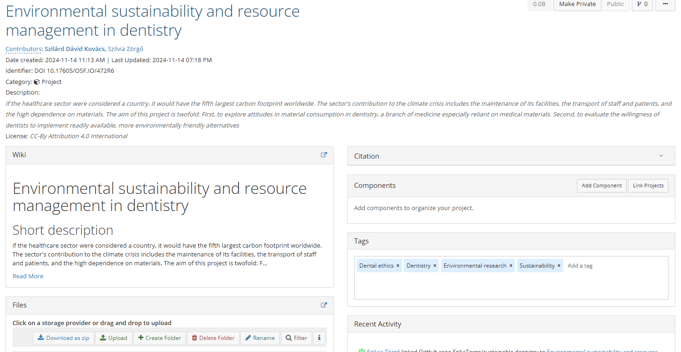

Slide 9
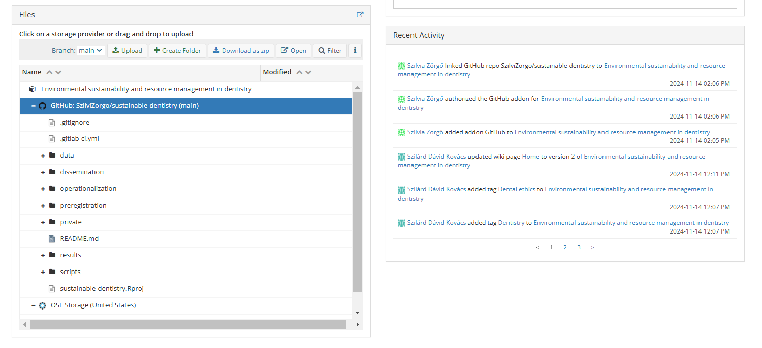

Slide 10
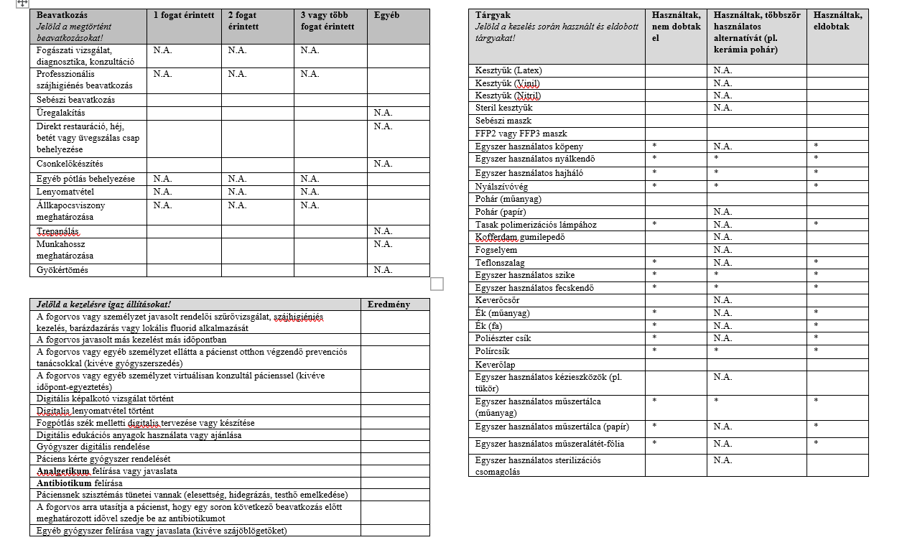
Structured observation
Per clinic:
Available types of waste containers: Domestic waste, Recyclable Waste, Infectious waste, Sharp object
Per patient:
Intervention: type(s) and number of teeth treated (if applicable)
Items used: disposed of, not disposed of, multiple-use alternative was used (if applicable)
Digital methods: Digital radiography, Digitally prescribing medicine, Teleconsultation, Digital educational materials, Digital impression, Digital planning or fabrication of prostheses
Prevention: Oral hygienic intervention (performed of advised), Discussion of oral self-care, Recommendation of further treatment
Medication: With or without intervention; Anitbiotics: Why?

Slide 11
Interviews
General questions:
Knowledge on sustainable dentistry,
What changes participants could introduce,
Do they / would they involve patients in making sustainable treatment choices
Specific questions related to:
Amount of interventions in one session,
Disposal of items,
Prevention,
Digital technologies,
Reducing prescribing medicine
How they see themselves
What possible changes they recognize
What barrier they recognize in implementing those changes
Would they implement changes in spite of caveats (e.g., more interventions -> more discomfort for the patient and higher risk of postoperative complications )

Slide 12
Sociodemographic survey
Sex assigned at birth
Year of birth
Place of occupation (Capital, County seat, Other city, Village)
Funding of the clinic (Private, Public)
Completed specialty programs

Slide 13
Epistemic Network Analysis (ENA)
Unified Qualitative-Quantitative method
Codes in qualitative research: Labels that indicate cocepts reflecting to the research aims
ENA creates quantitative models of qualitative data (depicts the relative frequency of code co-occurrences)

Slide 14
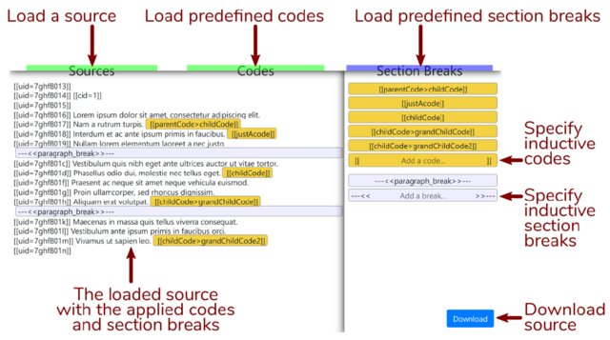
Code development and application
https://www.researchgate.net/profile/Szilvia-Zoergo/publication/358271361/figure/fig1/AS:1118768805756929@1643746677074/Interface-for-the-Reproducible-Open-Coding-Kit-iROCK_W640.jpg
Inductive development of a coding scheme with iterative steps:
Two coders conduct free, inductive coding on 10% of the data via the Interface for Reproducible Open Coding Kit (iROCK) https://i.rock.science
Coders triangulate their codes and defined a tentative codebook (contains: codes, definitions, examples)
Tentative codebook is tested on another 10% of the data and modified by the coders
The dataset is coded deductively per sentence after coders reach an agreement of .95 Cohen’s Kappa

Slide 15
Epistemic Network Analysis (ENA)
Tabularization of data via Reproducible Open Coding Kit {rock} R package: https://rock.science; Table contains: Lines of coded data, Participant ID, sociodemographic variables, codes
Construction of epistemic networks:
https://www.epistemicnetwork.org
High dimensional space: Vectors represent the code co-occurrences, and the length of the vectors represent the relative frequency of the code co-occurrences
Dimensional reduction (means rotation, singular value decomposition), high dimensional space is reduced to a two-dimensional space
2 visualizations:
Epistemic networks of individual units of analysis (participant, group, etc.)
Plotted points representing the entire dataset

Slide 16
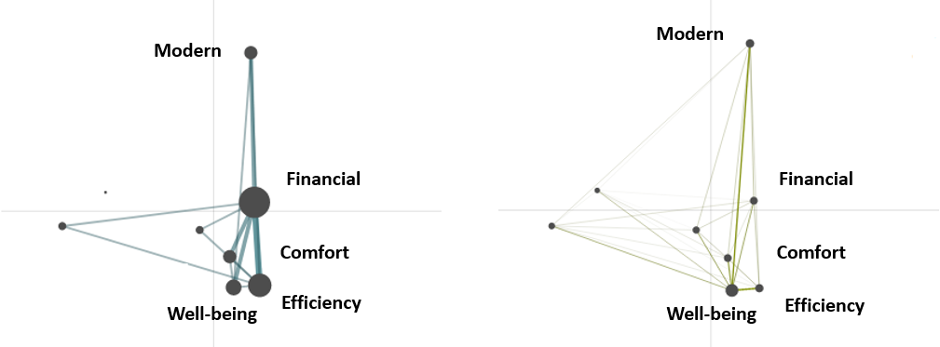
Mock epistemic networks
Mock mean epistemic networks of private (right) and public (left) dentists. Nodes (black circles) denote codes; node size indicates the relative frequency of the code co-occurring with other codes. Edhes (line) thicknesses and saturation correspond to the relative frequency of co-occurrence between each pair of codes

Slide 17
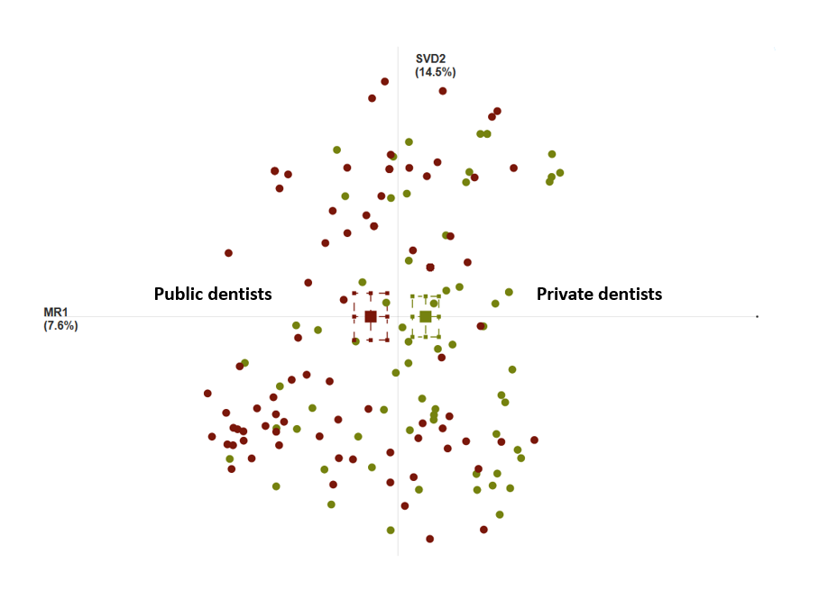
Mock plotted points
Mock ENA of projection space displaying individual network locations for each participant (colored circles) in the public dentist (red) and private dentist (green) subsamples, as well as mean network locations for both subsamples (colored squeares). Dashed lines around the means denote the 95% confidence intervals on each dimension.

Slide 18
Benefits of ENA
Quantitative models of qualitative data support the validity of the interpretation of the data
Researchers may utilize ENA to allow their interpretation of the qualitative data open to scrutiny
Insights (code co-occurrences) are fairly easily detectable
Groups based on theory or ad-hoc groups may be analyzed
Facilitates the comparison of multiple groupings of data providers (or individuals) without the need to examine them individually

Slide 19
Limitations of ENA
It is based on code pairs, whereas code triads, quads, etc. may also be meaningful; Frequency of codes in isolation may also be meaningful
Graphs serve as aids, the researcher needs to know the original data for accurate interpretation

Slide 20

Conclusions
Kovács, S.D. Patient autonomy in the era of the sustainability crisis. Med Health Care and Philos 27, 399–405 (2024). https://doi.org/10.1007/s11019-024-10214-x
Medicine in the 21st century needs to consider sustainability
While the most sustainable practices would reduce the number and the complexity of interventions, our study focuses on options that are readily available and do not undermine the quality of care
Contrasting the observations and interviews may shed light on the areas where sustainability is feasible and the obstacles of implementing such changes
The results may aid the development of educational materials for dentists and for patients
The study aims to contribute to the ethical discussion on the role of sustainability among the practitioners’ other obligations (patient’s well-being, patient’s autonomy, etc.); Our study informs the discussion with a practitioners’ point of view

Slide 21
Funding
SUPPORTED BY THE EKÖP-2024-2.1.1-EKÖP-2024-00004 UNIVERSITY RESEARSCH SCHOLARSHIP PROGRAMME OF THE MINISTRY FOR CULTURE AND INNOVATION FROM THE SOURCE OF THE NATIONAL RESEARCH, DEVELOPMENT AND INNOVATION FUND

Slide 22
References
D’Ancona, Grainne, Andrew Cumella, Charlotte Renwick, and Samantha Walker. 2021. The sustainability agenda and inhaled therapy: what do patients want? European Respiratory Journal 58. European Respiratory Society. https://doi.org/10.1183/13993003.congress-2021.PA3399.
Going green: what do the public think about the NHS and climate change? - The Health Foundation. 2024. https://www.health.org.uk/publications/long-reads/going-green-what-do-the-public-think-about-the-nhs-and-climate-change. Accessed January 4 2024
Kovács, S.D. Patient autonomy in the era of the sustainability crisis. Med Health Care and Philos 27, 399–405 (2024). https://doi.org/10.1007/s11019-024-10214-x
Lenzen, Manfred, Arunima Malik, Mengyu Li, Jacob Fry, Helga Weisz, Peter-Paul Pichler, Leonardo Suveges Moreira Chaves, Anthony Capon, and David Pencheon. 2020. The environmental footprint of health care: a global assessment. The Lancet Planetary Health 4: e271–e279. https://doi.org/10.1016/S2542-5196(20)30121-2.
Liew, K. L., and A. Wilkinson. 2017. P280 How do we choose inhalers? patient and physician perspectives on environmental, financial and ease-of-use factors. Thorax 72. BMJ Publishing Group Ltd: A235–A237. https://doi.org/10.1136/thoraxjnl-2017-210983.422.
Martin N, Sheppard M, Gorasia G, Arora P, Cooper M, Mulligan S. Drivers, opportunities and best practice for sustainability in dentistry: A scoping review. J Dent. 2021 Sep;112:103737. doi: 10.1016/j.jdent.2021.103737.

Slide 23
References
Pichler, Peter-Paul, Ingram S. Jaccard, Ulli Weisz, and Helga Weisz. 2019. International comparison of health care carbon footprints. Environmental Research Letters 14. IOP Publishing: 064004. https://doi.org/10.1088/1748-9326/ab19e1.
Richie, Cristina. 2019. Principles of green bioethics: sustainability in health care. East Lansing: Michigan State University Press
Rocque, Rhea J., Caroline Beaudoin, Ruth Ndjaboue, Laura Cameron, Louann Poirier-Bergeron, Rose-Alice Poulin-Rheault, Catherine Fallon, Andrea C. Tricco, and Holly O. Witteman. 2021. Health effects of climate change: an overview of systematic reviews. BMJ Open 11. British Medical Journal Publishing Group: e046333. https://doi.org/10.1136/bmjopen-2020-046333.
ten Have, Henk, and Bert Gordijn. 2023. Green bioethics. Medicine, Health Care and Philosophy 26: 497–498. https://doi.org/10.1007/s11019-023-10182-8.
WHO. 2023. Summary on environment, climate change and health for WHO representatives and other country staff.
Zielinski, Chris. 2022. COP27 climate change conference: urgent action needed for Africa and the world. Journal of Medical Ethics 48. Institute of Medical Ethics: e2–e2. https://doi.org/10.1136/jme-2022-108698.
https://www.parlament.hu/documents/d/guest/infojegyzet_2023_30_egeszsegugy_eghajlatvaltozas

Slide 24
Szilárd Dávid Kovács kovacs.szilárd@phd.Semmelweis.hu

